Slide 1

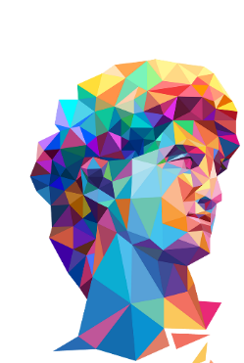
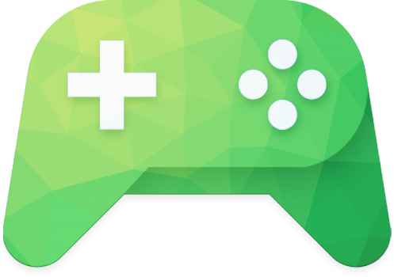


LANGUAGE: Spanish Latam

Slide 2

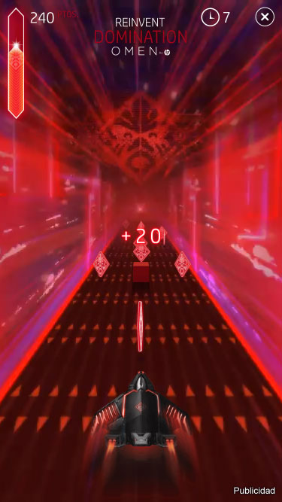
MECHANICS
The spaceship will auto-run on the screen.
Control the spaceship to move 1 in 3 lanes to collect items and avoid the obstacle.
Collect the items to fill the bar fully and trigger Frenzy state.
In Frenzy state:
  The spaceship will run faster.
  Double score when collecting the balls.
Control: Swipe left or right to control the spaceship.
Objective: Collect as balls as possible in 30 seconds.
SCORE CALCULATION
Collect the item = +10 pts.
Collect the item in the frenzy state = +20pts
Hit the obstacle = -30 pts

Slide 3

HOST GAME
INTERRUPT BEHAVIOUR
When interrupt occur: BGM and the game should be paused.
After interrupt (resume to host game): BGM and the game should be resumed from the pause.
Note : Interstitial shouldn't be closed after turning back from the redirection link.
POINTCUTS
SELECT “CLOSE”
INTERSTITIAL
SELECT “X” TO RETURN TO HOST GAME & RECEIVE REWARD
PLAY MIG
CASE – If end-users already finished the MIG then select REPLAY; but select “X” button before finishing the replay THEN end-users will receive the reward when back to host game.
ACTION PHASE
SELECT “REPLAY”
RESULT

Slide 4

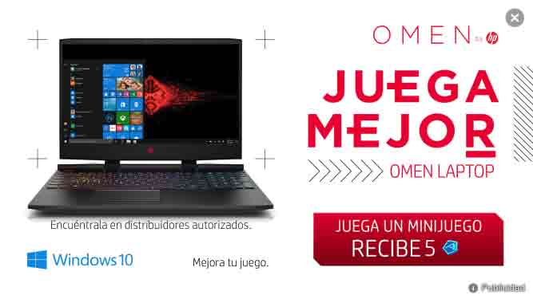
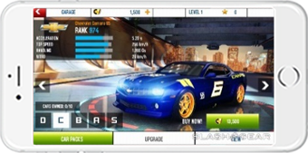

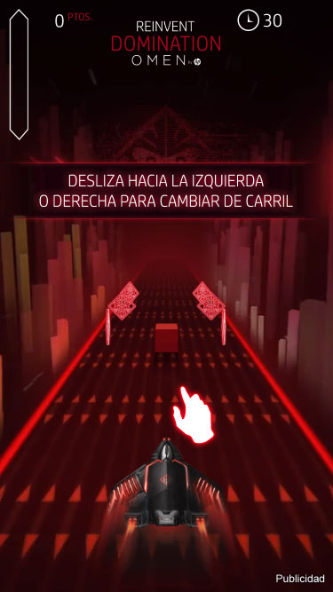

INTERSTITIAL SCREEN
HOST GAME
LOADING SCREEN
TUTORIAL SCREEN
ACTION PHASE
END SCREEN

Slide 5

MECHANICS
CLOSE BUTTON – Select it to return to the host game.
“PLAY A MINIGAME; RECEIVE [number][token]” - Tap on touchable zone to start playing the mini-game.
CURRENCY ICON – This will be changed dynamically depending on the host games.

Slide 6


MECHANICS
LOADING ANIMATION – The circle will be rotated automatically.
In case of bad/unstable internet connection – if the loading
time exceed 30 seconds , the RETRY and CLOSE button will
appear allowing users to select 1 in 2 actions:
  Select RETRY button to reload the MIG from the beginning.
  Select CLOSE button to close the MIG.
Texts:
  RETRY text: “RETRY”
  LOST_CONNECTION text: “PLEASE CHECK YOUR CONNECTION AND TRY AGAIN”
In case of no internet connection at the beginning - the RETRY and CLOSE button will appear immediately.

Slide 7

MECHANICS
Appear after the Loading screen.
The tutorial for a MIG is only played once. It won’t be displayed if the MIG is retriggered.
Close button will not appear in the tutorial phase.
Follow the tutorial instruction to start play session.
NOTE:
  When the player replay MIG, tutorial won't appear.
  On Android, the user cannot use “Back” key to close the game.

Slide 8

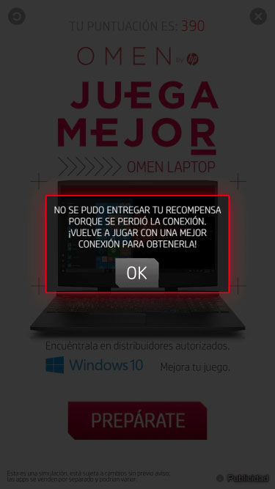
MECHANICS
CLOSE BUTTON: Select it to return to the host game AND receive the reward.
“REPLAY” BUTTON: Select to replay the mini-game.
CTA BUTTON: Select it to visit the redirection link.
INFO BUTTON: Select it to redirect to Gameloft’s info page.
BAD CONNECTION
If the game is disconnected to server. The text “YOUR REWARD COULD NOT BE DELIVERED DUE TO A LOST CONNECTION. REPLAY WITH A BETTER CONNECTION TO GET IT!” will appear.
To be able to get reward, users need to replay the MIG with a better connection, without closing the MIG.

Slide 9

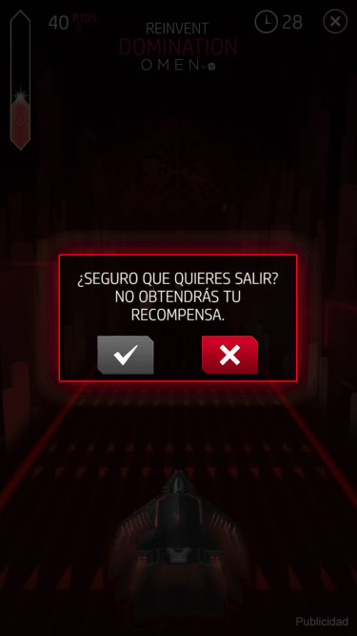
MECHANICS
Taps “Close Button” in Action Phase to open the “Exit Game Popup” .
  This popup will only appear when playing the game in the Action Phase for the first time.(also need internet connection is good).
  If the player replays the game, Tap “Close Button” (In AP) will return the host game directly.
  Texts appear in the popup: ”ARE YOU SURE YOU WANT TO QUIT? YOU WILL NOT GET YOUR REWARD”.
On Android, the user can use “Back” key to open “Quit Game popup”.
ELEMENTS
“QUIT” - Quit button: This button is used to return the host game.
“RESUME” - Resume button: This button is used to resume the game.

Slide 10

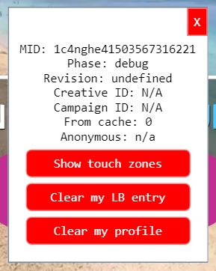

TRIGGER SUPPORT POPUP (ONLY FOR TEST)
Drag from left to right in the first screen to trigger support popup.
Tap on the “Clear my profile” button to clear the profile.
Re-trigger the MIG to see tutorial again.

Slide 11

INFORMATION
ANIMATED FIRST INTERSTITIAL:
  Limit size rule: 800 KB.
  Size: 313 KB
Total size of the MIG:
  Limit size rule for 3D game: 5 MB.
  Limit size rule for 2D game: 3 MB.
  Size: 2.8 MB

Slide 12



